Slide 1


Slide 2
D.C. Lobbying Requirements
Lobbyists
(D.C. Code §§ 1-1162.27-1-1162.32)
Applicability

Slide 3

  BEGA Statute:
    The Ethics Act
    Jurisdiction
  BEGA Structure:
    Five-member Board
    Office of Open Government
    Office of Government Ethics

Slide 4
Who is a Lobbyist?
A lobbyist is any person who engages in lobbying.
“Lobbying” means communicating directly with any official in the legislative or executive branch of the District government with the purpose of influencing any legislative action or an administrative decision.
D.C. Code § 1-1161.01

Slide 5
LOBBYING IN THE DISTRICT OF COLUMBIA
Lobbying Defined
Example of “lobbying” activity that would require registration and filing of reports with BEGA:
ABC Company opposes legislation that would set the District’s hourly minimum wage to $17.50. It pays a lobbyist firm (“Firm”) $5,000, to help it in communicating with District officials regarding its opposition to the legislation. Firm communicates with various councilmembers regarding opposition to the bill.
ABC Company and Firm must register as lobbyists with BEGA because they expended and received over $250, respectively, for lobbying. All expenditures related to this matter and any meetings or communications between the firm and the councilmembers regarding the opposition to the legislation must be disclosed on lobbying activity reports.

Slide 6
Advocacy Vs. Lobbying
While all lobbying is advocacy, not all advocacy is lobbying
  Advocacy is any action that speaks in favor of, recommends, argues for a cause, supports or defends, or pleads on behalf of others
  Key words
    direct contact with D.C. government agencies or officials
    purpose to influence
    a legislative action or administrative decision
Whether your contact with D.C. government is advocating or lobbying, sharing the public’s opinions on matters are welcome
  Just remember that if you were paid $250 or more for your advocacy within a three-month reporting period for your contact with D.C. government, you may have to register!

Slide 7
LOBBYING IN THE DISTRICT OF COLUMBIA
Lobbying Defined
What is not “Lobbying”:
  The appearance or presentation of written testimony by a person on his or her own behalf, or representation by an attorney on behalf of any such person in a rulemaking (which includes a formal public hearing), rate-making, or adjudicatory hearing before an executive agency or the Tax Assessor;
  Information supplied in response to written inquiries from an agency or any public official;
  Inquiries concerning only the status of specific actions;
  Testimony given before the Council or a committee of the Council, during which a public record is made of such proceedings or testimony submitted for the record;
  Indirect Contact, such as communication made through the instrumentality of a newspaper, television, or radio of general circulation, or a publication whose primary audience is the organization’s membership; and
  Communications by a bona fide political party.
D.C. Official Code §1-1161.01(32)(B).

Slide 8
LOBBYING IN THE DISTRICT OF COLUMBIA
Lobbying Defined Continued
What is not “lobbying”:
Grassroots communications: The act of asking the public to contact officials concerning issues and legislation.
A non-profit supports $17.50 minimum wage legislation and encourages the public to speak with District officials in support of it.
Members of the public who communicate with District officials in support of this bill are engaging in lobbying, because they are having direct communications with District officials with the intent to influence legislation, but they do not have to register as lobbyists because they are not receiving compensation. The non-profit would not need to register as a lobbyist in this effort alone. If a registered lobbyist did not have any direct communications with public officials regarding this matter, then it would not have to report this activity on its lobbying activity report.

Slide 9
LOBBYING IN THE DISTRICT OF COLUMBIA
Lobbying Defined Continued
What is other activity that would require registration with BEGA:
Procurement communications:
  Communications with District officials regarding government contracting or a purchasing decision are not “lobbying”
  There must be an intent to influence legislative action or administrative decision.
  Example:
    A company hires a firm to assist it in influencing the contents of a District RFP and submitting a bid proposal to the District. The company wins the contract and the firm interfaces with a District agency regarding the status of the contract award and later regarding invoice issues. None of these communications/interactions with the District amount to “lobbying,” because there is no intent to influence legislative action or an administrative action.
  EXCEPTION: Contracts more than $1 million (during a 12-month period) require Council review and involve legislative action (through the introduction of a resolution either approving or disapproving the proposed contract). See D.C. Official Code § 2-352.02.

Slide 10
LOBBYING IN THE DISTRICT OF COLUMBIA
Lobbying Defined Continued
Scheduling communications:
  Communications with District officials to set up a meeting with a public official.
  This alone is not “lobbying,” and would not need to be disclosed in lobbying activity reports.

Slide 11
Filing registration Reports

Slide 12
Persons Required to Register
A person shall register with the Director of Government Ethics pursuant to § 1-1162.29 and pay the required registration fee if:
  The person receives compensation or expends funds in an amount of $250 or more in any 3-consecutive-calendar-month period for lobbying.
  A person who receives compensation from more than one source shall register under this section if the person receives an aggregate amount of $250 or more in any 3-consecutive-calendar-month period for lobbying.
Note that both the Lobbyist and the client of the lobbyist must register.
Lobbyist must register on or before January 15th of each year, or no later than 15 days after becoming a lobbyist
Failure to register as required by this section shall result in a civil penalty.

Slide 13
Registration Fee
Registration will not be certified until the fee is paid;
The Registration fee for lobbyist is $250;
If you are a nonprofit organization OR a lobbyist who lobbies solely for tax exempt 501(c)(3) nonprofit organizations, the registration fee is $50;
The electronic payment system accepts credit cards;
If a check is submitted, it should be payable to the DC Treasurer;
A check will not be considered submitted until it arrives at BEGA and receipt is date stamped.

Slide 14
Exceptions
A public official, or an employee of the United States acting in his or her official capacity;
A publisher or working member of the press, radio, or television who, in the ordinary course of business, disseminates news or editorial comment to the general public;
A candidate, member, or member-elect of an Advisory Neighborhood Commission; or
An entity specified in § 47-1802.01(4), whose activities do not consist of lobbying, the result of which shall inure to the financial gain or benefit of the entity.

Slide 15
Civil Penalty for Failure to Register or File Activity Reports
D.C. Code § 1-1162.32
Notwithstanding § 1-1162.21 and except as provided in subsection (c) of this section, any person who willfully and knowingly violates any of the provisions of this part shall be fined not more than $5,000, or imprisoned for not more than 12 months, or both.
Any person who files a report or registration form required under this part in an untimely manner shall be assessed a civil penalty of $10 per day up to 30 days (excluding Saturdays, Sundays, and holidays) that the report or registration form is late. The Board may waive the penalty imposed under this subsection for good cause shown.
As a courtesy, BEGA will send notice to all registrants to remind them of upcoming due dates for Activity Reports.
Each day an activity report or registration is late, a registrant or client shall be fined $10 a day, up to $300.

Slide 16
Filing Activity Report

Slide 17
Activity Reports
D.C. Code § 1-1162.30
Each registrant shall file with the Director of Government Ethics between the 1st and 15th day of January, April, July, and October of each year a report signed under oath concerning the registrant’s lobbying activities during the previous quarter. If the registrant is not an individual, an authorized officer or agent of the registrant shall sign the form.
A registrant shall file a separate activity report for each person from whom he or she receives compensation.

Slide 18
Activity Reports
D.C. Code § 1-1162.30 (continued)
The reports shall be public documents and shall be on a form prescribed by the Director of Government Ethics and shall include the following:
  (A complete and current statement of the information required to be supplied pursuant to § 11162.29;
  Total expenditures on lobbying broken down into the following categories:
    Office expenses;
    Advertising and publications;
    Compensation to others;
    Personal sustenance, lodging, and travel, if compensated;
    Other expenses;
  Note: BEGA will send reminder notices to file.

Slide 19
Activity Reports Continued
D.C. Code § 1-1162.30
  Each expenditure of $50 or more shall also be itemized by the date, name, and address of the recipient, and the amount and purpose of the expenditure;
  Each political expenditure, loan, gift, honorarium, or contribution of $50 or more made by the registrant or anyone acting on behalf of the registrant to benefit an official in the legislative or executive branch, a member of his or her staff or household, or a political committee or political action committee established for the benefit of the official, be itemized by date, beneficiary, amount, and circumstances of the transaction; including the aggregate of all expenditures that are less than $50;
  Each official in the executive or legislative branch and any member of the official’s staff, including personal and committee staff, who has a business relationship or a professional services relationship with the registrant shall be identified by name and the nature of the business relationship with the registrant.

Slide 20
Activity Reports Continued
D.C. Code § 1-1162.30
  The name, position, and agency or office of each official in the executive or legislative branch and member of the official’s staff with whom the registrant has had written or oral communications;
  A precise description of the subject matter, including the title of any bill, proposed resolution, contract, reprogramming, or other legislation, of all written or oral communications related to lobbying activities;
  Each person whom the registrant has given compensation to lobby on his or her behalf; and all bundled contributions.

Slide 21
NOTE:
The Lobbyist Registration and Reporting e-file system recently had some upgrades and updates.
Please Note that if there are ANY outstanding fees, you CANNOT file an activity report until the fee has been paid.

Slide 22
BEGA Discontinuing Lobbyists Fine Grace Period
Starting on April 1, 2024, BEGA will no longer allow a grace period for late registrations or activity reporting. The grace period extended through the pandemic will now be discontinued. Accordingly, all registered lobbyists and clients must timely file all registration forms and activity reports or face a $10 penalty for each day the filing is late, up to $300. Fines will now accrue and be imposed after each statutory deadline. For example, activity reports for 2024 Quarter 1 are due on April 15, 2024, any activity report filed on April 16, 2024 or after, will receive a $10/day late penalty.

Slide 23
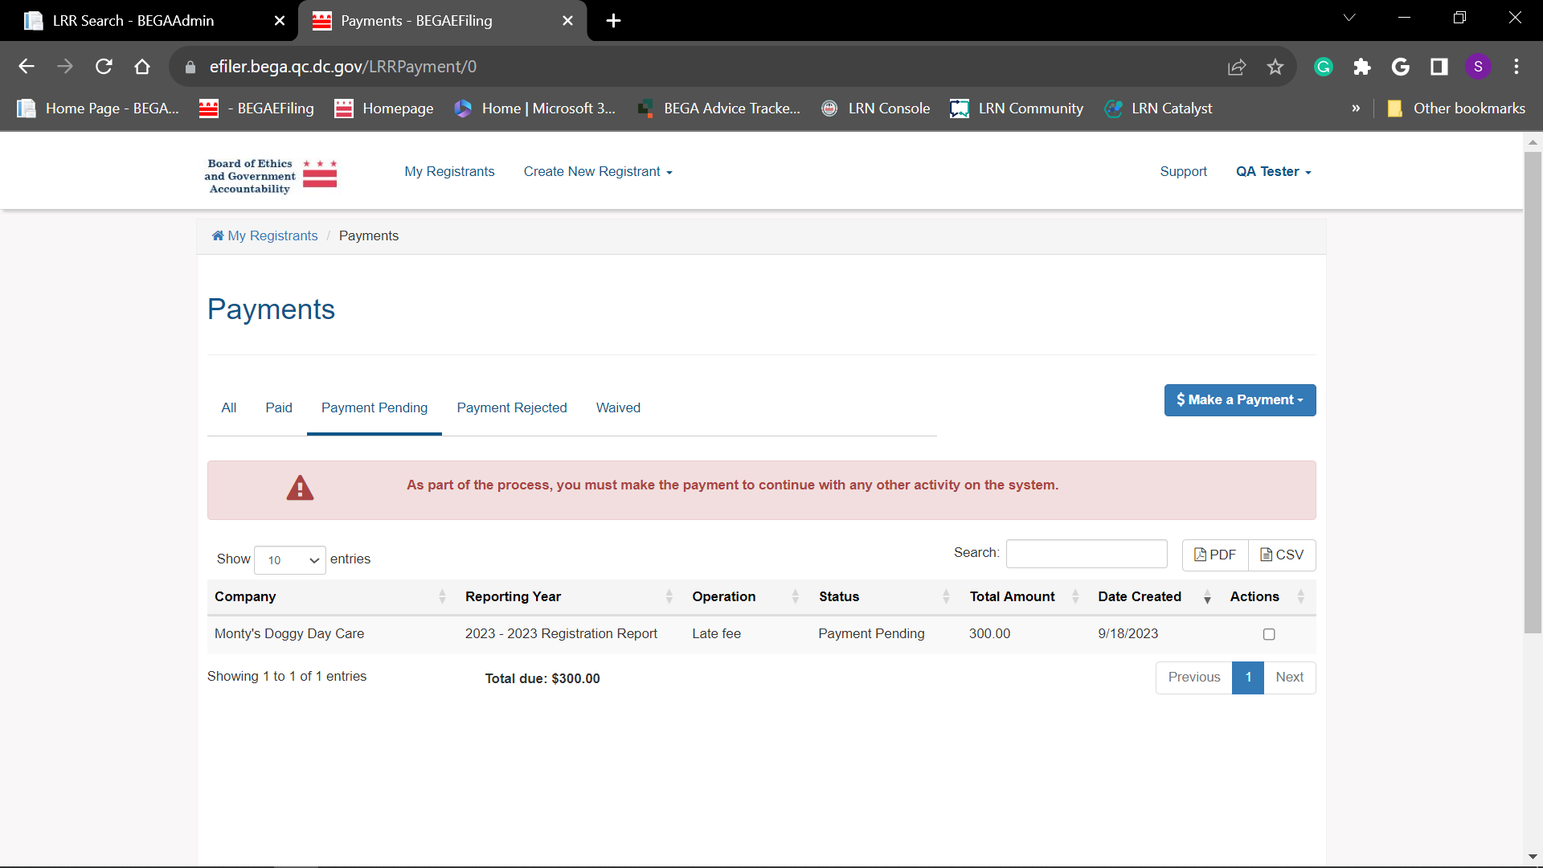
If there is a balance owed, the following error message will appear. You will not be able to move forward until this matter is corrected.

Slide 24
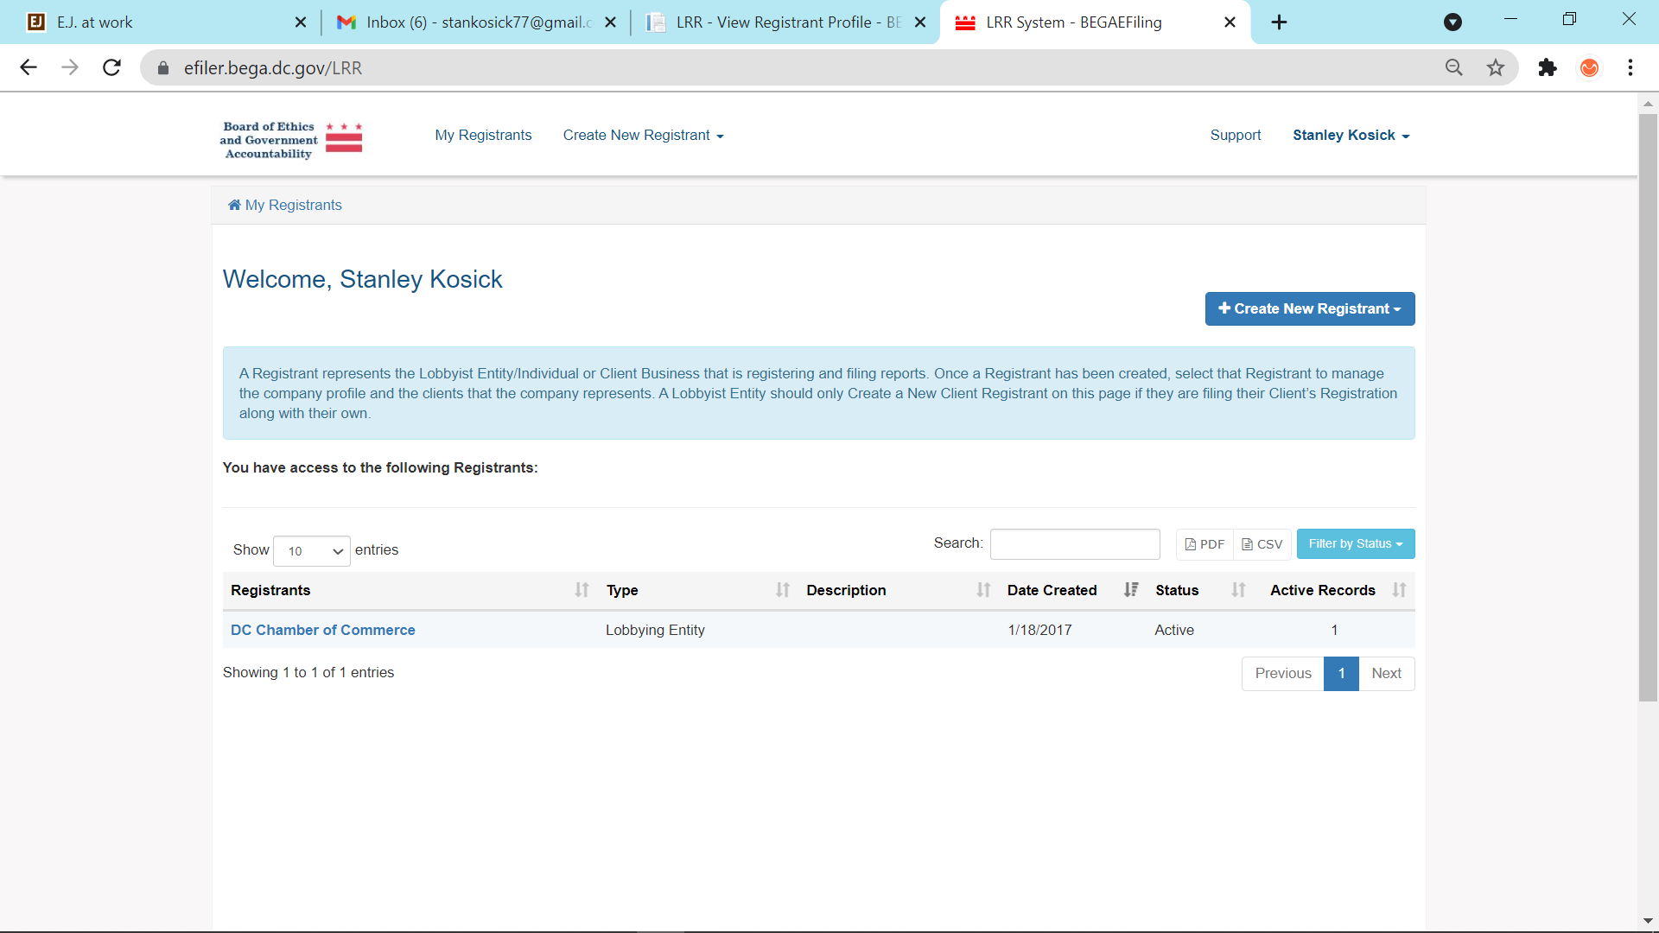
Step 1. Select Registrant to open.
SELECT

Slide 25
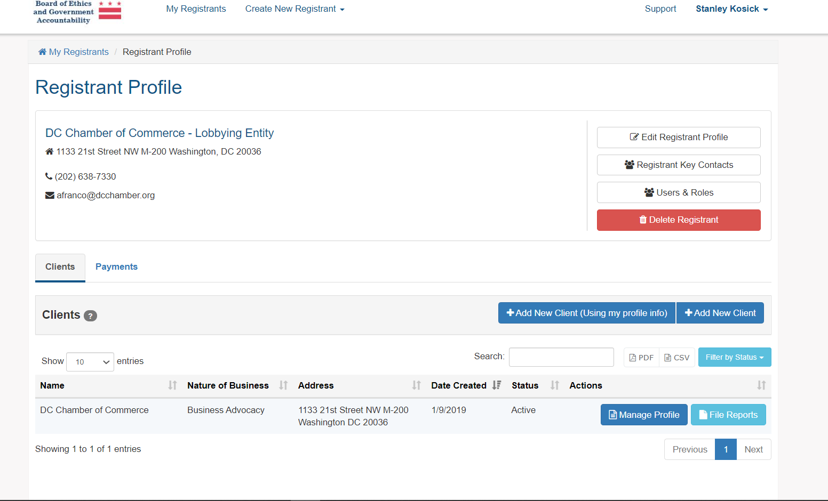
Step 2. Select Manage Profile
SELECT

Slide 26
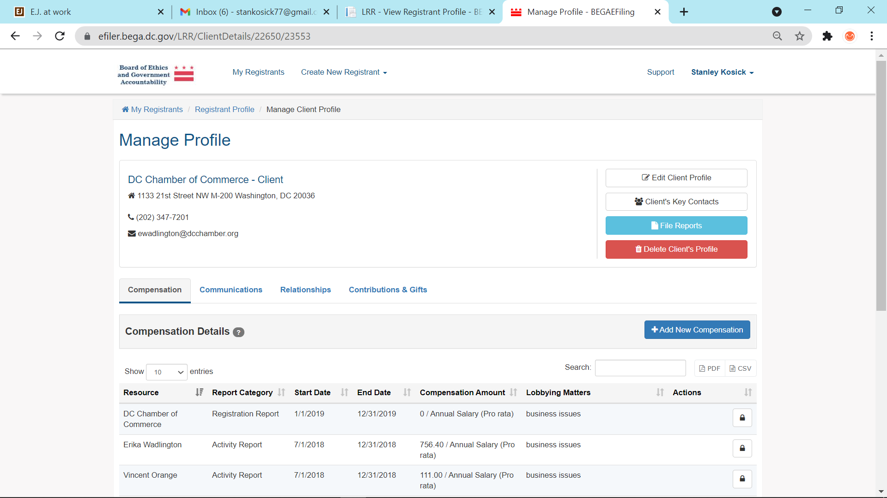
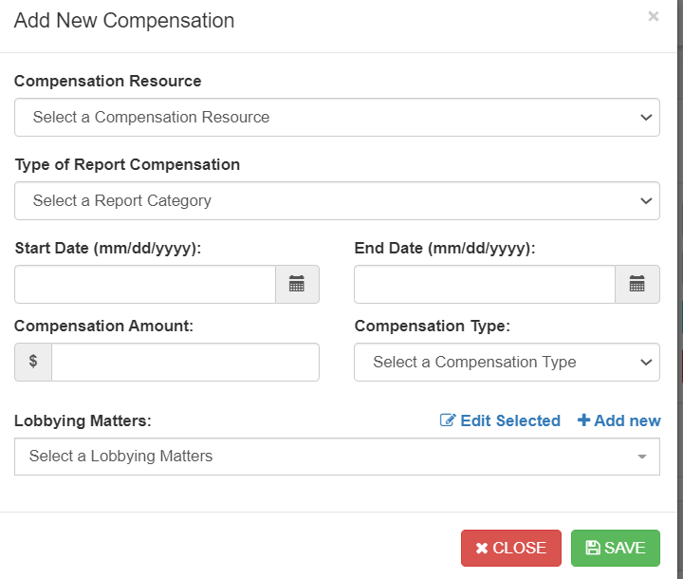
Step 3. Add New Compensation
SELECT

Slide 27
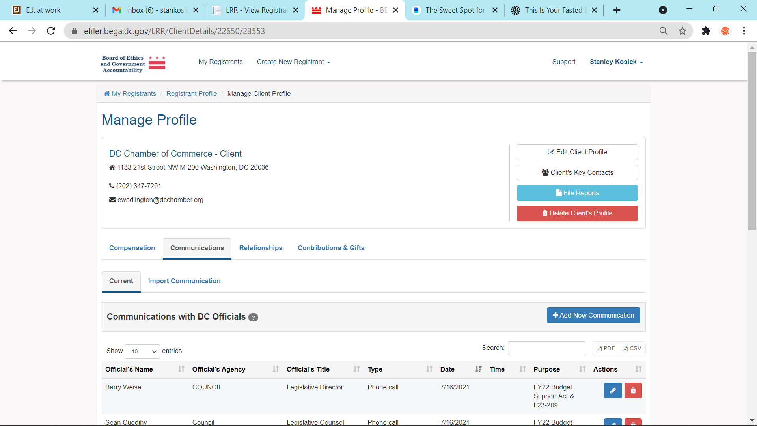
Step 4. Add New Communication
Select

Slide 28
Select
Step 5. File Reports

Slide 29
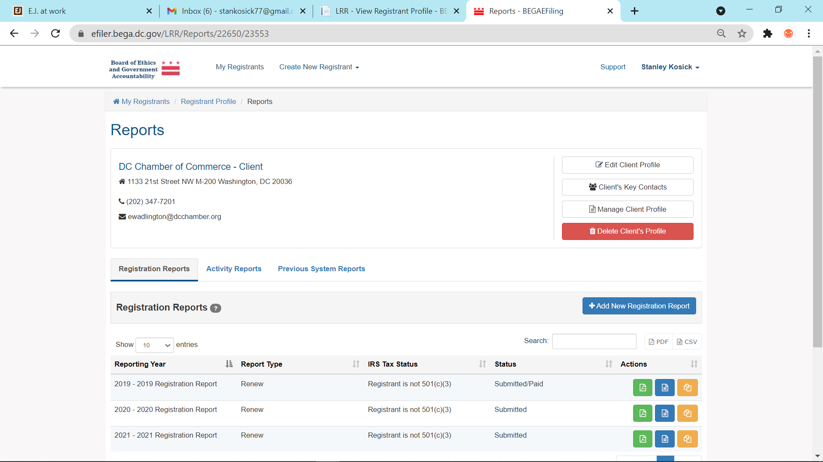
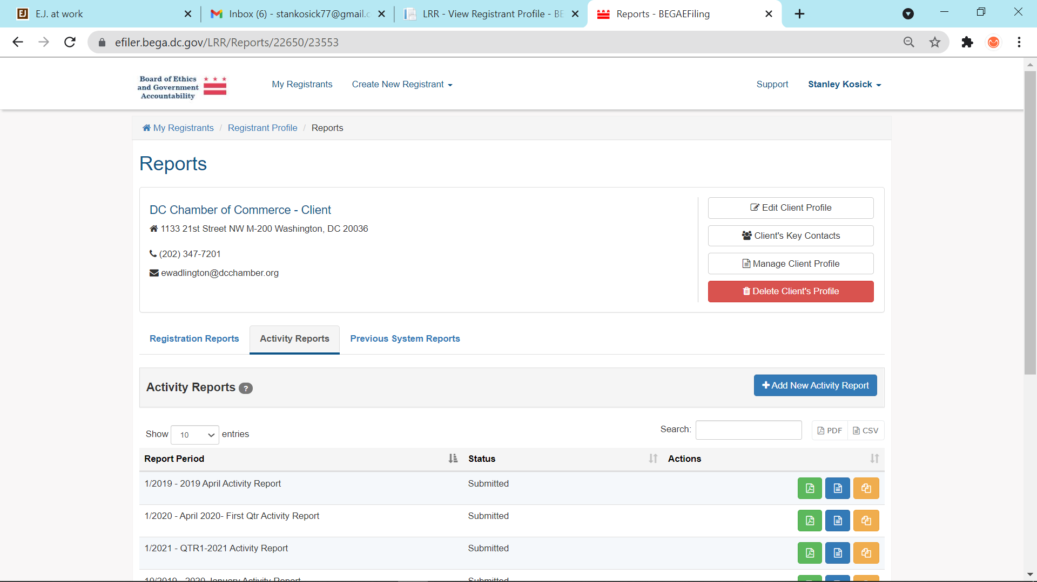
Step 6. Add Activity Report
Select
Select

Slide 30
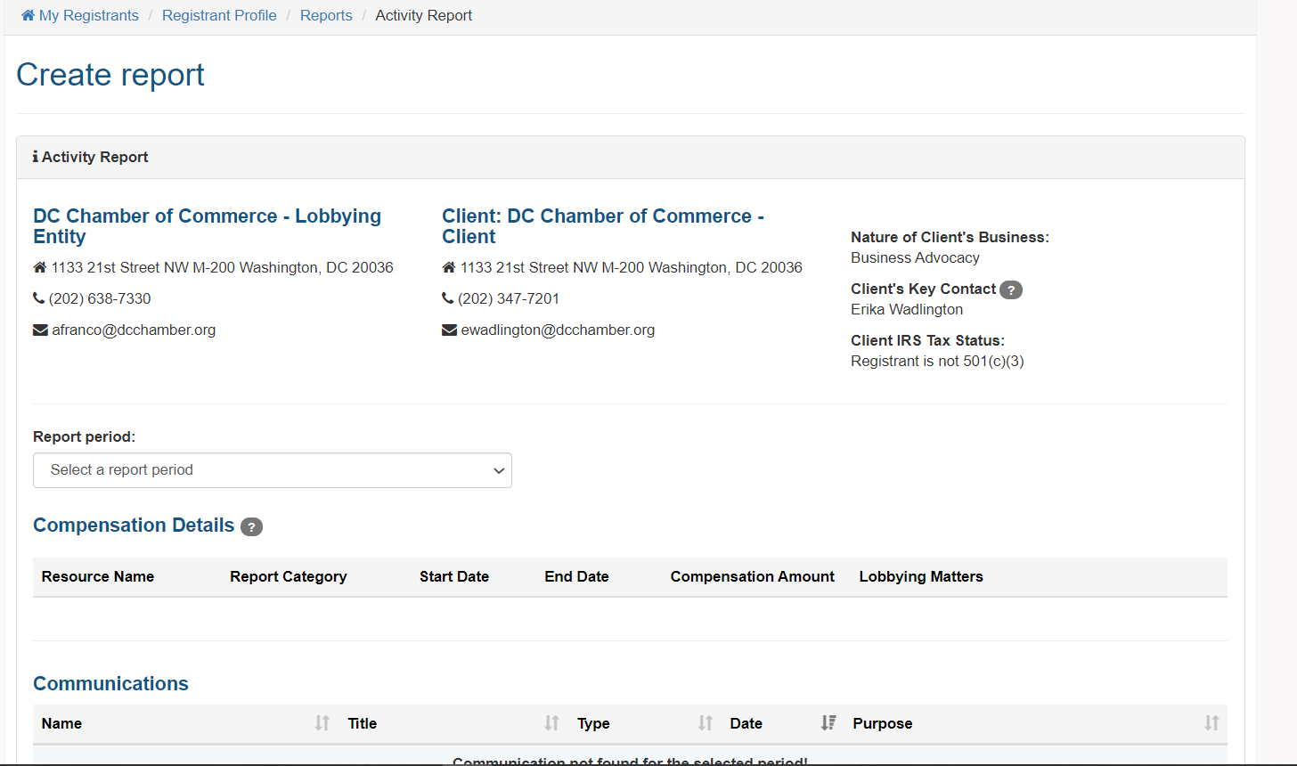
Step 7. Check for Accuracy

Slide 31
Renewing Lobbyist Registration

Slide 32
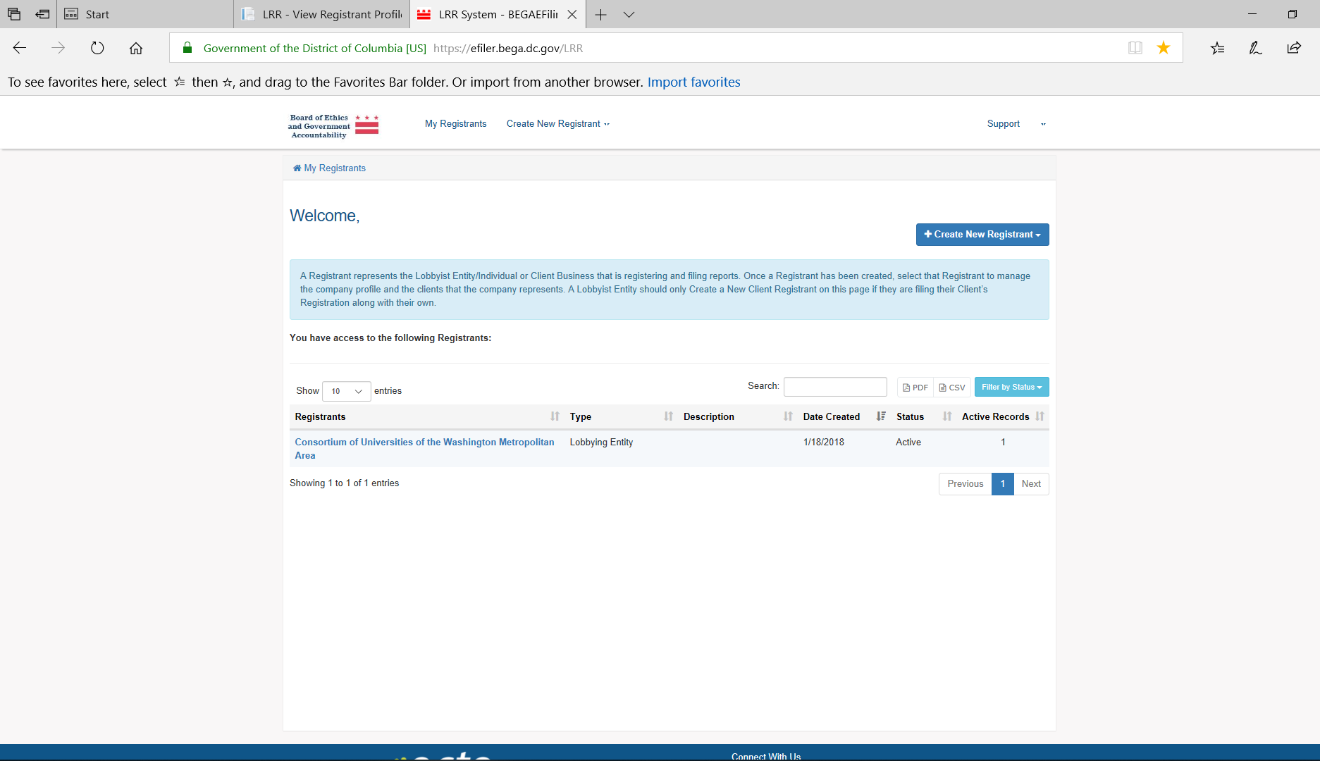
Step 1. Select Registrant to open.
SELECT

Slide 33
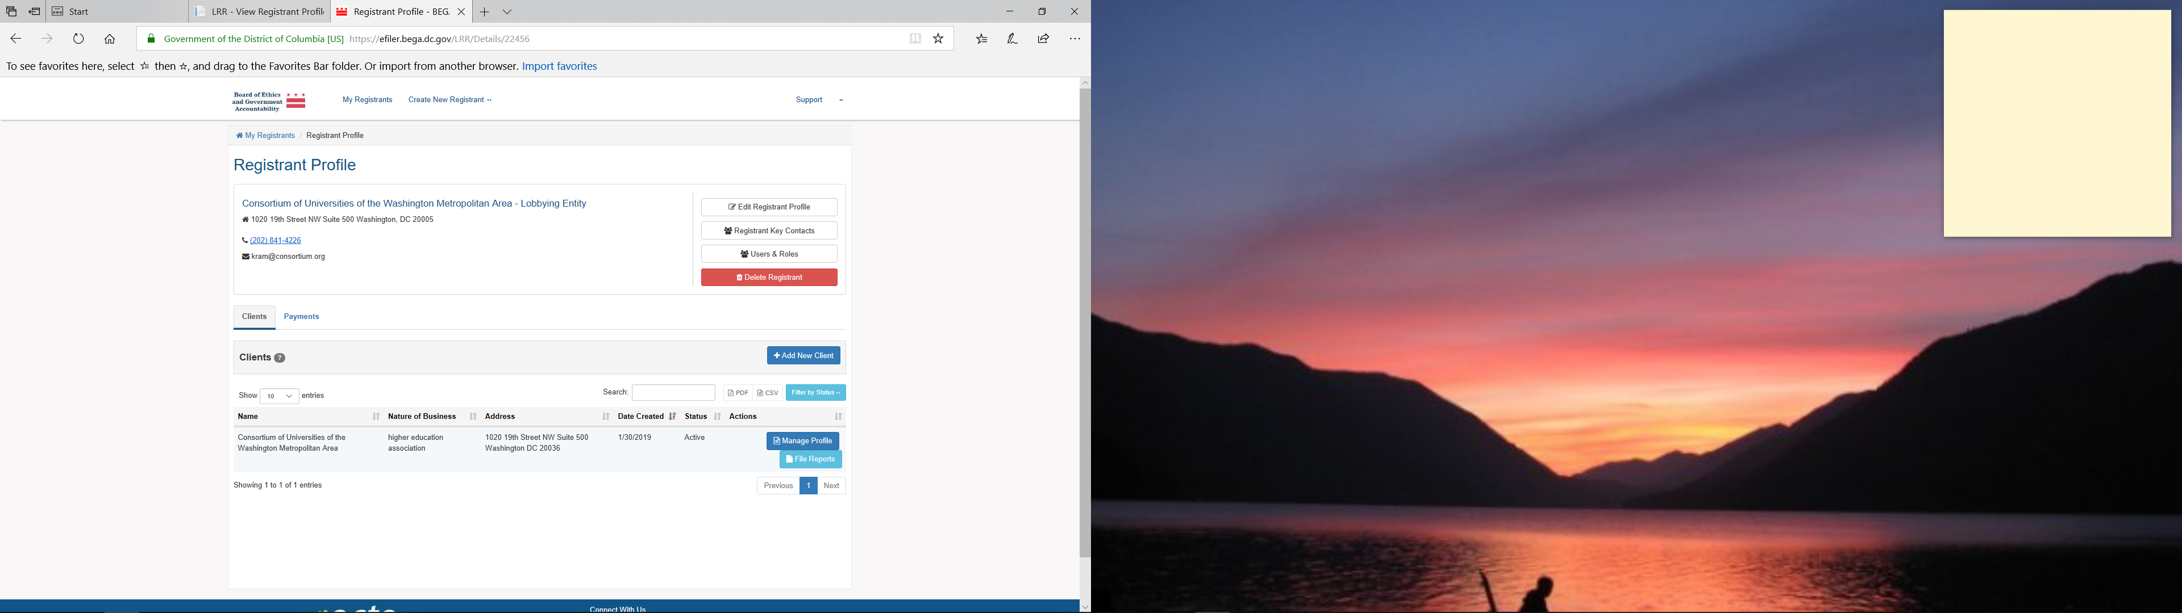
Step 2. Select “Manage Profile”
Select Manage Profile

Slide 34
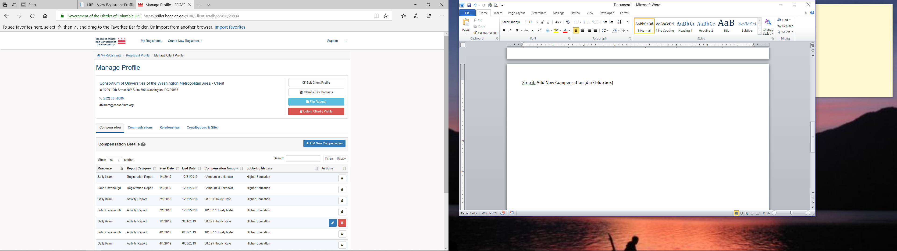
Step 3. Add New Compensation
Add New Compensation

Slide 35
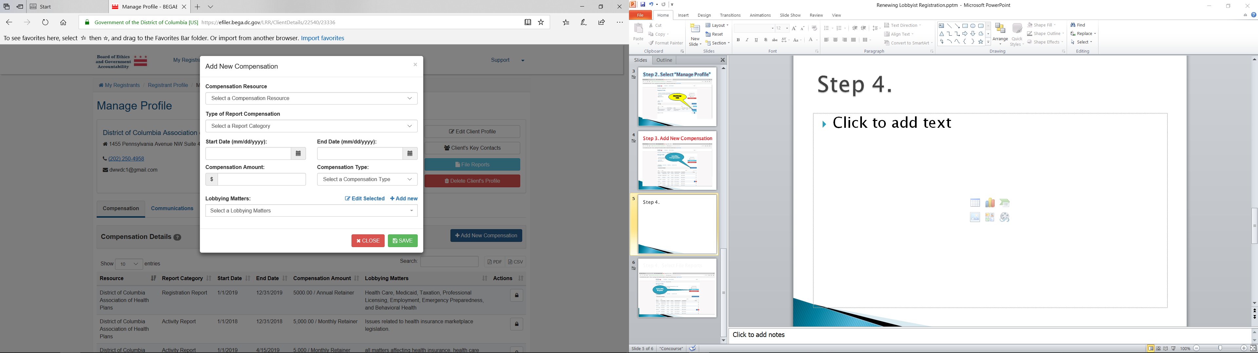
Step 4. Fill Accordingly and Save

Slide 36
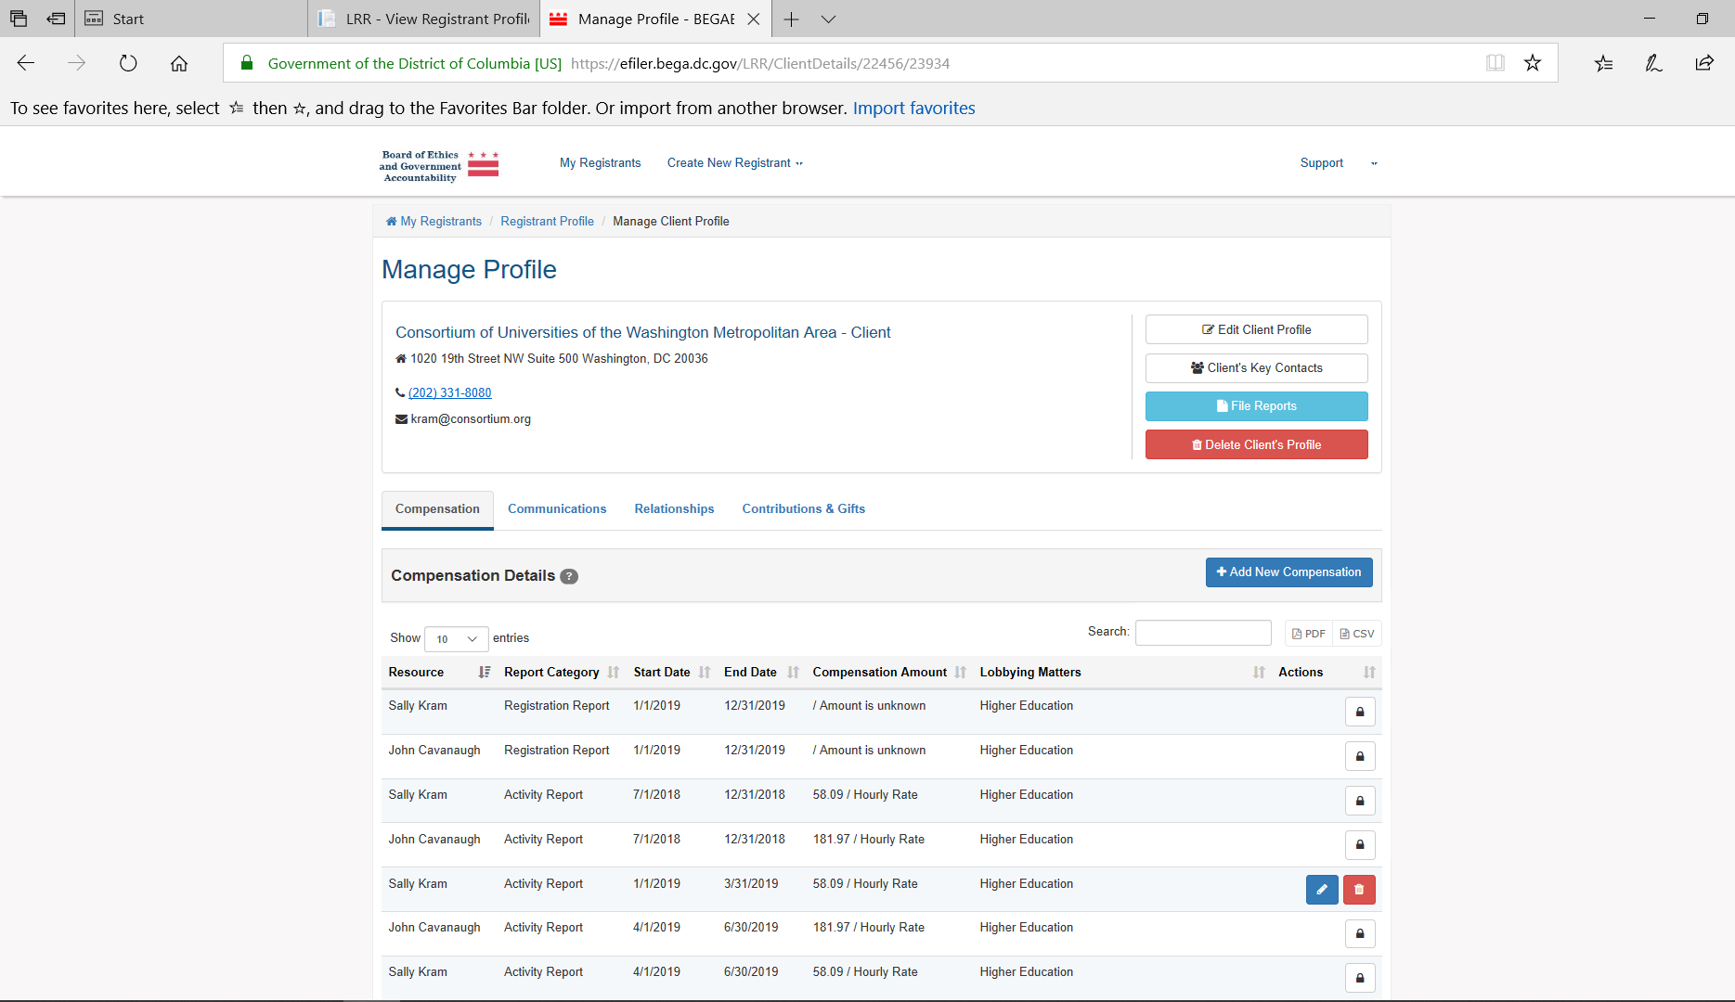
Step 5. Select File Reports
Select File Reports

Slide 37
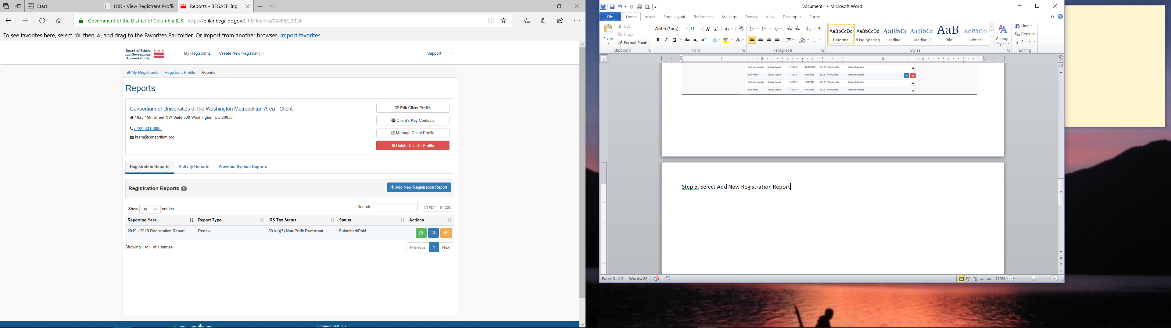
Step 6. Add New Registration Report
Add New Registration Report

Slide 38
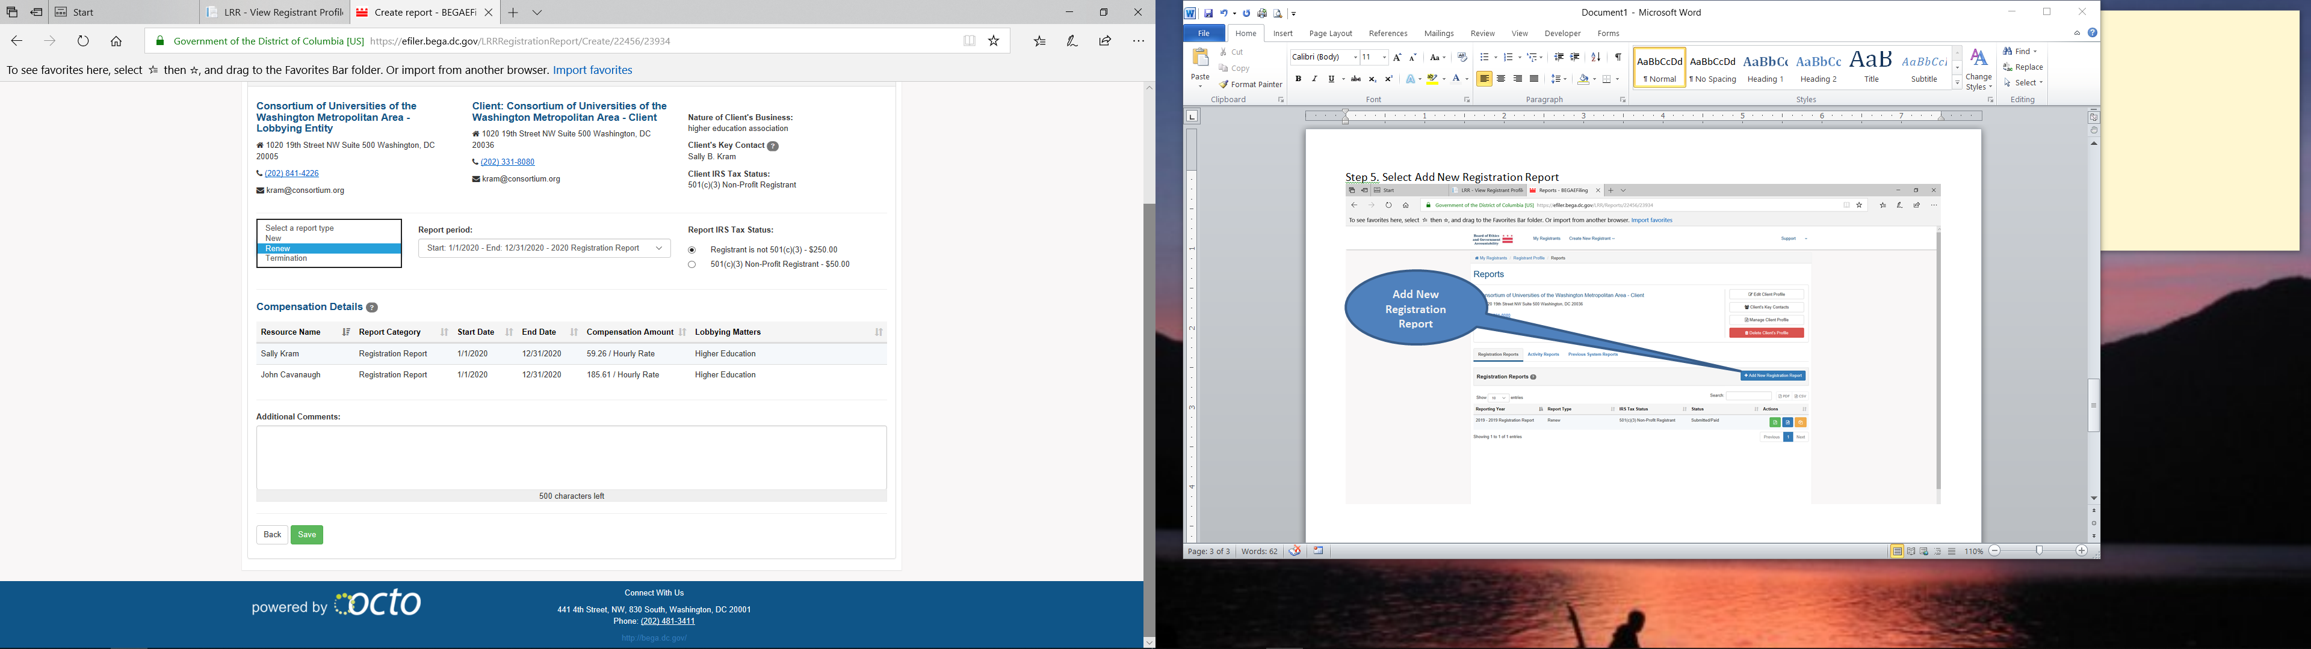
Step 7a. Select Report Type
Step 7b. Select Report Period

Slide 39

Step 8. Save and “Certify!” Registration
*absent certification, registration will not be complete*

