Slide 1


ETHICS WEEK 2026
TRANSITIONING ETHICALLY
OCTOBER 13-16, 2026
Introduction
Ashley D. Cooks, Director of Government Ethics
www.bega.dc.gov
Notes:
Welcome to our 6th annual Ethics Week. I am Ashley Cooks, the Director of the Office of Government Ethics. Thank you all for joining us. This is our annual conference in which we deliver information on government ethics and transparency. This year’s theme is Transitioning Ethically. We have designed sessions that focus on that theme and the Code of Conduct which will take place over the next four days.

Slide 2

Board of Ethics and Government AFive-eof Government Ethics/ Office of Open Government ccountability
Board of Ethics and Government Accountability
Five-member board
Office of Government Ethics/ Office of Open Government
Notes:
For those of you are not familiar with The Board of Ethics and Government Accountability, also known as BEGA, we are an independent agency of the District government, and we were created to be the District’s ethics and open government authority. As such, BEGA is charged exclusively with administering and enforcing the District’s ethics laws. The Board itself consists of a five member panel of individuals that are appointed by the mayor and confirmed by the council.
BEGA has jurisdiction over the entire District government and its instrumentalities, including members of the: Executive branch, Legislative branch, Independent agencies, Advisory Neighborhood Commissions and all Boards & Commissions.
Within the BEGA structure, there is the Office of Open Government (OOG), which has oversight of government transparency and provide Open Meetings Act and Freedom of Information Act training. There is also the Office of Government Ethics (OGE), which is handles ethics matters and is comprised of investigators and attorneys, as well as support staff.
Our mission is to ensure that the government operates in an ethical and transparent manner which protects the integrity of the government and ensures public trust.

Slide 3

Office of Government Ethics
Advice
Training
Investigation
Financial Disclosure Statements
Lobbyist Registration and Reporting
Notes:
OGE ensures compliance with the Code of Conduct which is a set of regulations and statutes that make up the ethics. We have a small staff of 17 employees who serve the entire 37,000 employees and public officials.

Slide 4

Transition Defined
a change or shift from one state, subject, or place to another
a period or phase in which such a change or shift is happening
something that links one state, subject, place, to another : a connecting part or piece
a passage of discourse in which a shift (as of subject or location) is affected
a new beginning
Notes:
Transition defined
1: a change or shift from one state, subject, place, etc. to another
a peaceful/orderly transition of power
the actor's transition to directing
a period or phase in which such a change or shift is happening
… you're at the cusp, kids. You're at the edge between childhood and everything that comes after.
the transition period between moving out of your parents' house and starting a household of your own
something that links one state, subject, place, etc. to another : a connecting part or piece
[The front porch] served … as a vital transition between the uncontrollable out-of-doors and the cherished interior of the home.
a passage of discourse in which a shift (as of subject or location) is effected
Every aspect of the book—its narrative transitions, dramatic changes in pictorial scale, fluctuations of mood, interlinking of visual themes—is handled with pinpoint control.
a passage linking two sections of a piece of music : bridge
Furthermore, in two instances where new musical ideas are introduced … Mozart provides a musical transition to connect the new section with the preceding one.

Slide 5
The Need for Change
(1) an ending
(2) a neutral zone
(3) a new beginning.
Notes:
Every transition starts with a need for change. Whether it be a voluntary change or involuntary, the need is still present.
Transition is a constant and unsettling process that offers the chance of growth and redemption. – Michael Bungay Stainer – The Coaching Habit
I recently read Transitions: making sense of Life’s changes by William Bridges.
As humans we face a lifetime of transitions.
You may be facing a transition into a new career, job, a promotion in your current agency. The transition can be a personal one, maybe dealing with a relationship (birth of child, loss of a parent or spouse, or physical (health).
All transitions include (1) an ending (2) a neutral zone (3) a new beginning.
The ending: letting go of old things before we can pick up new ones –can be a difficult and scary task, but is necessary inorder to transition and fulfill that need for change. You may find some resistance within yourself. It may be an abrupt ending or a slow ending. Whatever the process, it must happen to start a transition
The second part of transitioning is the neutral zone. According to the author it is the place in between the ending and a new beginning. An example is a street crossing procedure, in which a person has stepped off the curb of the one side of the street and is crossing the street to the other side. It would not be wise to remain in the middle of the street, so once you step off the curb it’s best to move to the other side as fast as you can. And whatever you do don’t sit down on the center lane. It could be a period of self renewal or self assurance. A time to reflect on prior decisions while moving forward. It’s the middle period.
The last part is a new beginning which is the outcome of your change. That new beginning may be a new career or job or just a new place in your life.

Slide 6
An Ethical Transition
Code of Conduct
Conflicts of Interest
Outside employment/activities
Post-employment
Notes:
As you transition in your careers and employment with the District gov. You must be mindful of the decisions and the ethics rules while doing so. There are certain rules that deal specifically with transitioning to a new career, leaving government service or adding addition employment to your life. The first rule to be mindful of whenever you're contemplating a change in your career is the financial conflicts of interest rule. The rule is trigger from the moment you begin seeking future or outside employment. You must ensure that you don’t take any official action that would financially benefit yourself or a potential employer.
The second rule to remember are the outside employment restrictions. You may be thinking about starting that new job while still employed with the District government. While employees are allowed to engage in outside employment there are certain restrictions that they must abide by when engaging in that outside employment. Employees are prohibited from engaging in outside employment that conflicts with District government employment. The ethics rules provide a non-exhaustive list of instances that conflict with government service, such as engaging in outside employment during your tour of duty or using government resources, representing an outside entity before the District, capitalizing on your official title, divulging non-public info, and teaching, writing, or consulting using official government information.
And finally there are the post employment rules, apply to employees after government service. The rules restrict your communications and representations before the District government, as well as behind the scene information you provide to your new employer. We have a course that will drive into the details of these rules.
We have a ethical transition packet which includes AOs, one pager on post employment, outside employment, and even some LHA.

Slide 7
Ethical Updates

Slide 8
Training & Education
7,000+ LMS registered users
16,000+ employees trained
90+ training courses
Notes:
The first key to transitioning ethically and just government service in general is a continuous ethics education program. You must attend ethics trainings on at least a biannual basis. And attend a various of different trainings, including courses that refresh you on the ethics code and courses that discuss the theoretical framework of ethics within the government. An ethics education is not a one-time effort but its on-going. Even after ten years I still find new ideas and information about maintaining a complaince office when I attend conferences.
In FY25, over 7,000 employees registered for our learning management system. We provide 26 online, on-demand training courses through our LMS. It’s accessible via our website, employees can self-register, and complete courses on the every topic of the Code of Conduct as well as courses on ethical leadership, ethical culture carriers and other courses on maintaining an ethical government.
We trained over 16,000 employees via in-person and virtual sessions.
Conducted over 100 training courses
Develop the mindset that ethics is important year-round and that you should continuously seek to educate yourself on it.

Slide 9
Advice
Informal and Formal Advice
Implement open channels of communication with employees - Ask BEGA, advice requests via email, in-person, and telephone
Seek proactive ethics advice = Ask Before You Act
Notes:
We provide advice in two forms – informal and formal advisory opinions. Informal – email, telephone, walk-in. Formal – advisory opinion. Both give the requesting employee safe harbour. We reserve formal opinions for novel questions, information that needs to be shared, or trends in conduct.
We provided 354 answers to informal ethics advice requests. Issued 4 Advisory Opinions in FY25 and FY26. AOs entitled: “Outside Employment with Third-Party Delivery Business”; “Outside Activity by Board Member”; “Representation Through Testimony” and “Lobbyist Registration and Reporting” All are available on our website.
Important to seek advice before you act.
Include new Ask Ms. Ethics button

Slide 10
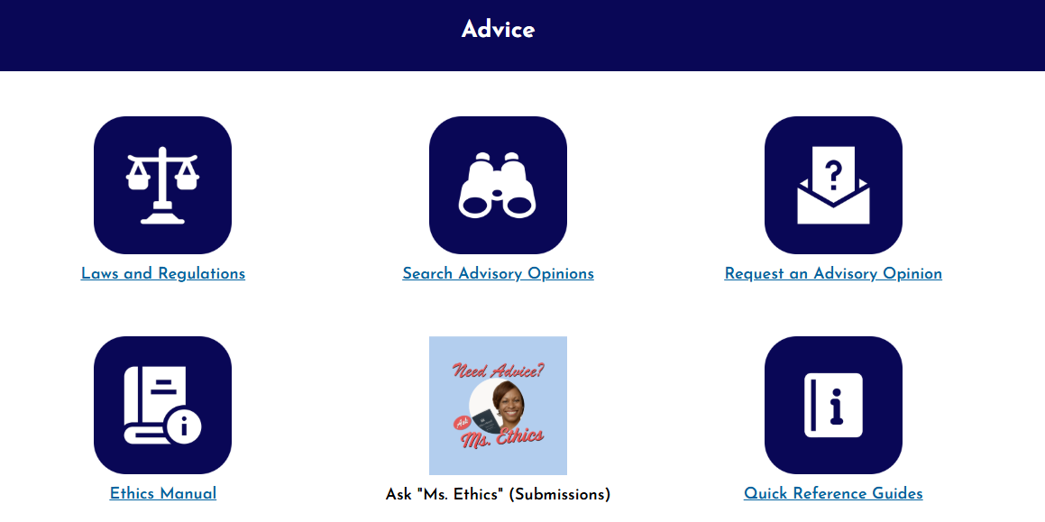
Advice
Notes:
Ww now have a new way of submitting ethics advice requests. On the advice page on our website there is an Ask Ms. Ethics button which will allow for employees to submit their questions via quickbase. This is an addition to the existing methods in which advice is sought – telephone, email, walk-in.

Slide 11
Ethics Investigations
231 Complaints - 144 Investigations initiated
16 Negotiated Dispositions
2 Public Hearing
Outside Employment, Misuse of Government Property, Conflicts of Interest, Financial Disclosure
Notes:
Employees have a duty to report creditable ethics violations. When you report ethics violations those you do not follow the rules are held accountable. We are charged with investigating and adjucacting violations of the Code of Conduct. We conduct investigations based on complaints that we receive, media posting or other means by which information is received. We look at every single complaint to determine whether we have jurisdiction, then convert those matters to investigations. If there is evidence of an ethics violation, a civil penalty or another form of action is taken against the offending employee, such as verbal counseling or an informal admonition. The Board has the authority to issue a fine of up to $5,000 per violation. A good amount of our investgations are dismissed for a lack of evidence, but there are others that are resolved through a negotiated disposition, informal Show hearing, or a formal hearing before the Board.
Outside employment remains the top subject area for complaints we receive and investigate. In FY25 and FY26 entered into 16 negotiated dispositions for cases in which we made a finding of an ethics violation. We began to see an increase in this area during and after the pandemic and despite our efforts to educate employees and enforce these rules the number of violations have been continuous.
We’ve also made finding in several investigations that have resulted in show cause hearing or non-public informal admonition.

Slide 12
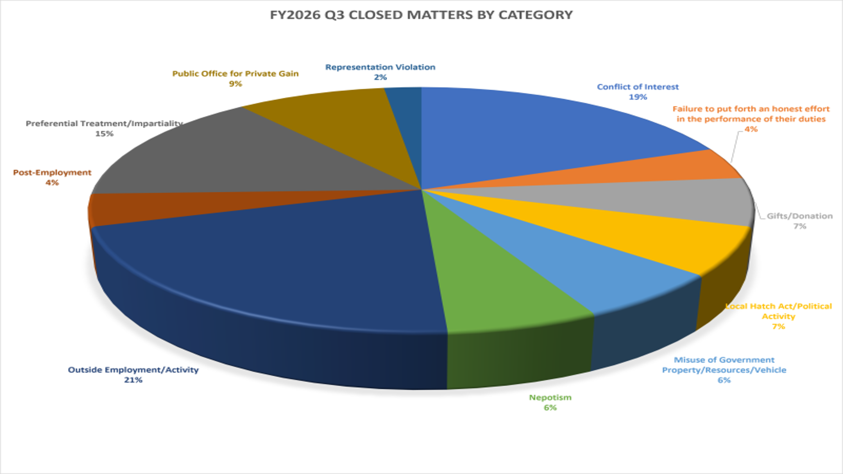
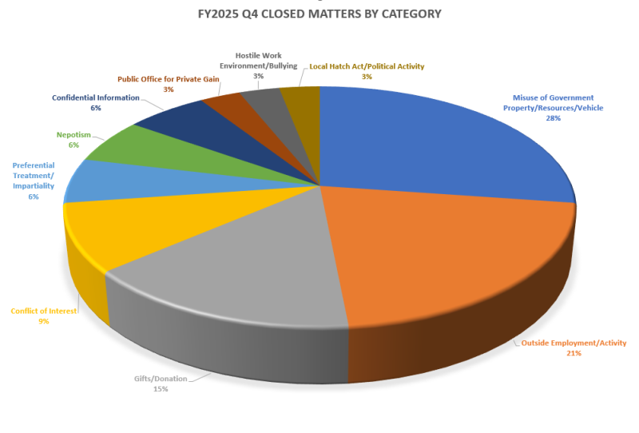

Slide 13
Disclosing Financial Interests
Avoid Financial Conflicts of Interest
Recusal
Annual Filing Requirement
Notes:
It’s important to disclose financial interests to avoid any financial conflict of interests, thereby violating the conflict of interest statute. Employees are required to avoid engaging in matters that would financially benefit themselves or a person closely affiliated with them. The best course of action to recuse from engaging in those matters that would cause you to violate this rule.
That means filing a written recusal with your supervisor and BEGA that describes the conflict and then fully stepping back from the matter. The COI statute is an ethics rule and it carries criminal penalties that may be enforced by the USAO or OAG.
The annual financial disclosure statement is a key measure in preventing financial conflicts of interest. Per the Ethics Act, public officials and certain employees who engage in duties such as procurement, administration of grants, regulatory matters, licensing, or matters that create a COI or the appearance of a COI must file annual statements. BEGA is the administrative the District’s disclosure program and this past year we opened the season with 10,000 filers and ended with about 85% percent of timely filing.
In FY25 we managed the collection of 9,094 financial disclosure statements and in FY26 managed 8,692.
As I previously stated abiding by the COI statute is critical when seeking or negotiating for employment . Under the statute any potential employer is a person closely affiliated with you once you begin the seeking process. Therefore, you are prohibited from taking any action that would financially benefit that potential employer or yourself.

Slide 14
Lobbyist Registration and Reporting
Quarterly Reporting
Training
Annual Filing Requirement
Notes:
We are responsible for the managing the District’s lobbying program. Any person that expends or receives funds for lobbying activity in the District must file an annual registration report and quarterly activity reports. In FY25 we collected 581 registrations and 1,729 activity reports and in FY26 we collected 592 registrations and 1,958 activity reports.
We also continue to host lobbyists trainings on a quarterly basis, which includes education on the lobbying restrictions.

Slide 15

Department of Energy and Environment
District Department of Transportation
Department of Health
Office of the Chief Financial Officer
Office of Contracting and Procurement
Department of Motor Vehicles
Department of Disability Services
Department of Insurance, Securities, and Banking
Fire and EMS Department
Department of Licensing and Consumer Protection
Office of the Inspector General
Department of For-Hire Vehicles
Public Service Commission
Office of the City Administrator
D.C. Housing Finance Agency
Alcoholic Beverage and Cannabis Administration
Office of Risk Management
Office of the D.C. Auditor
Office of Neighborhood Safety & Engagement
Notes:
Top 4 Agencies per size with 90% or greater filing rate of on-time filers.

Slide 16

Element #6 Leading by Example
Commit to the actions you want to see others do and inspire others be an ethical leader.
Notes:
Next presentation starts in 10 minutes,

